Slide 1
SQL Project: Exploring Global Happiness with SQL
Robert Bejenaru – Data analyst career program

Slide 2
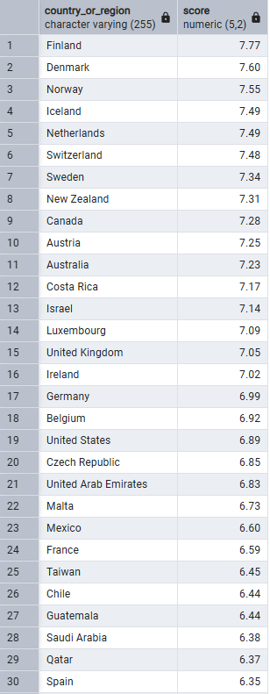
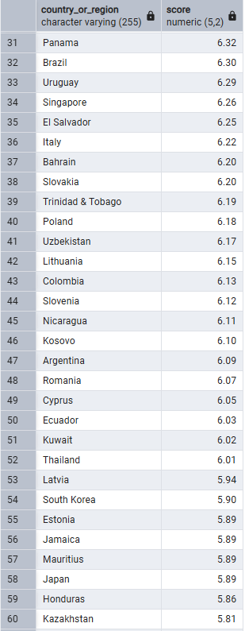
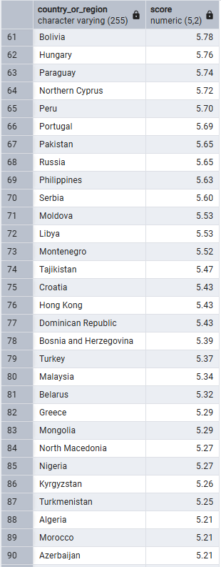
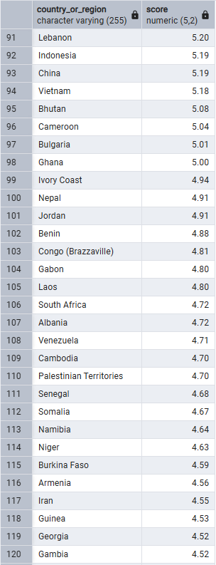
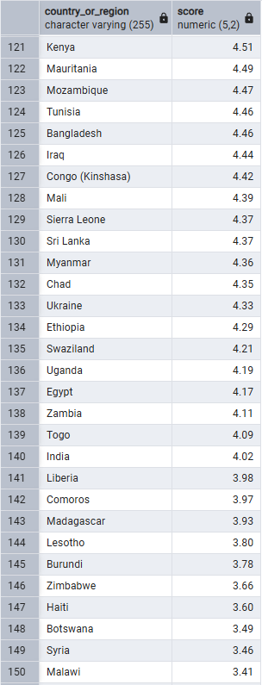

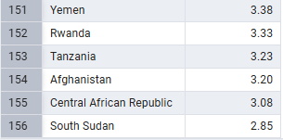
All Countries and their happiness scores

Slide 3
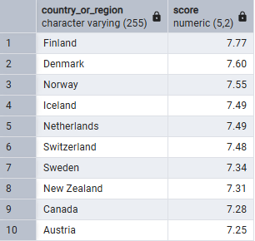
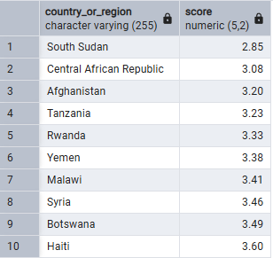
Top 10 happiest VS Bottom 10 Countries
Top 10
Bottom 10

Slide 4
Dataset Overview
NUMBER OF COUNTRIES | 156
AVERAGE GLOBAL HAPPINESS SCORE | 5.41
AVERAGE GDP PER CAPITA | 0.91
AVERAGE SOCIAL SUPPORT | 1.21
AVERAGE HEALTH LIFE EXPECTANCY | 0.73
AVERAGE FREEDOM TO MAKE LIFE CHOICES | 0.39
AVERAGE GENEROSITY | 0.19
AVERAGE PERCEPTIONS OF CORRUPTION | 0.11

Slide 5
Average Global Happiness Score
NUMBER OF COUNTRIES | 156
AVERAGE GLOBAL HAPPINESS SCORE | 5.41
AVERAGE GDP PER CAPITA | 0.91
AVERAGE SOCIAL SUPPORT | 1.21
AVERAGE HEALTH LIFE EXPECTANCY | 0.73
AVERAGE FREEDOM TO MAKE LIFE CHOICES | 0.39
AVERAGE GENEROSITY | 0.19
AVERAGE PERCEPTIONS OF CORRUPTION | 0.11

Slide 7
Top 5 countries with the highest social support

Slide 8
Top 5 countries ranked by healthy life expectancy

Slide 9
15 lowest corruption perception countries vs happiness scores
Key Insights:
Most of the higher happiness scores (7–7.77) are concentrated where corruption perception is between roughly 0.28 and 0.40
This suggests countries with lower perceived corruption tend to report higher happiness
There is an outlier at corruption perception (0.41) with a very low happiness score (3.33)
This point significantly deviates from the overall pattern

Slide 10
Generosity vs happiness correlation (above vs below average generosity)
Key Insights:
The difference of generosity (0.01) is minimal, suggesting generosity levels are relatively similar regardless of whether happiness is above or below average
Since the below average happiness group shows slightly higher generosity, this indicates generosity may not be a strong predictor of overall happiness
Due to the small gap between the two groups, other variables such as income, social support, health, or corruption perception may play a larger role in determining happiness scores

Slide 11
Countries with the largest difference between GDP rank and happiness rank
Country | Happiness Rank | GDP Rank | Rank Difference
Botswana | 148 | 65 | 83
Guatemala | 27 | 100 | 73
Hong Kong | 76 | 9 | 67
El Salvador | 35 | 102 | 67
Uzbekistan | 41 | 106 | 65
Nicaragua | 45 | 110 | 65
Iraq | 126 | 65 | 61
Iran | 117 | 56 | 61
Costa Rica | 12 | 69 | 57
Honduras | 59 | 115 | 56
Tajikistan | 74 | 126 | 52
Egypt | 137 | 87 | 50
Key Insights:
Hong Kong (GDP rank 9, Happiness rank 76) stands out as a wealthy country with much lower happiness ranking (difference of 67). This indicates that high income alone does not guarantee high well-being.
Countries (Happiness vs GDP) such as Guatemala (27 vs 100), El Salvador (35 vs 102), Nicaragua (45 vs 110), and Uzbekistan (41 vs. 106) rank higher in happiness than in GDP
This suggests non-economic factors (social support, culture, community ties) may significantly influence happiness.

Slide 12
Recommendations for policy makers
Prioritize Social Well-being
While GDP plays a vital role in prosperity, the data suggests that other factors including social support, trust and corruption levels, have a stronger impact on happiness.
Policymakers should focus on improving social services, healthcare and community to enhance overall happiness.
Countries with the highest social support are the happiest. For example, Iceland (1.62 social) is rank 4 in happiness and Finland (1.59 social) is rank 1 in happiness.
Combat Corruption for Greater Happiness
Countries with lower corruption perception tend to report higher happiness levels.
Implementing strong anti-corruption measures, transparency and accountability in governance could improve citizens’ quality of life.
Encourage Other Avenues Over GDP Alone
The large difference between GDP rank and happiness rank, especially in countries like Guatemala and Botswana, suggests that improving in other areas rather than just economic output, can lead to greater happiness.
Policymakers should focus on development that balances economic growth with other variables such as freedom to make life choices and increasing life expectancy.

